Slide 1
MDOC Grand Rounds Student Guidelines

Slide 2
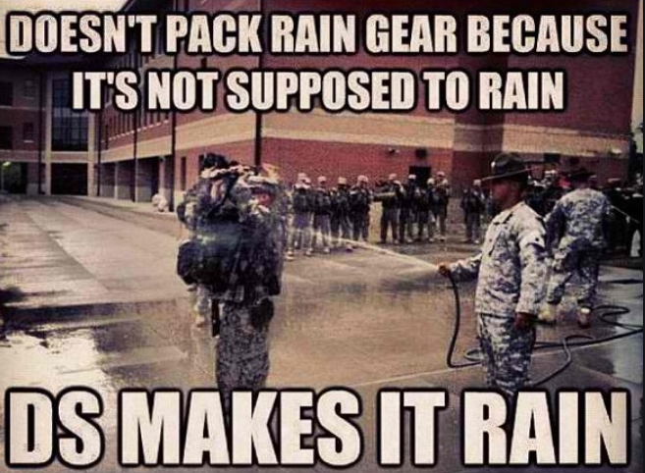
Inclement weather disclaimer:
- Be prepared for audibles to be called on locations of events 2/2 rain or inclement weather.

Slide 3
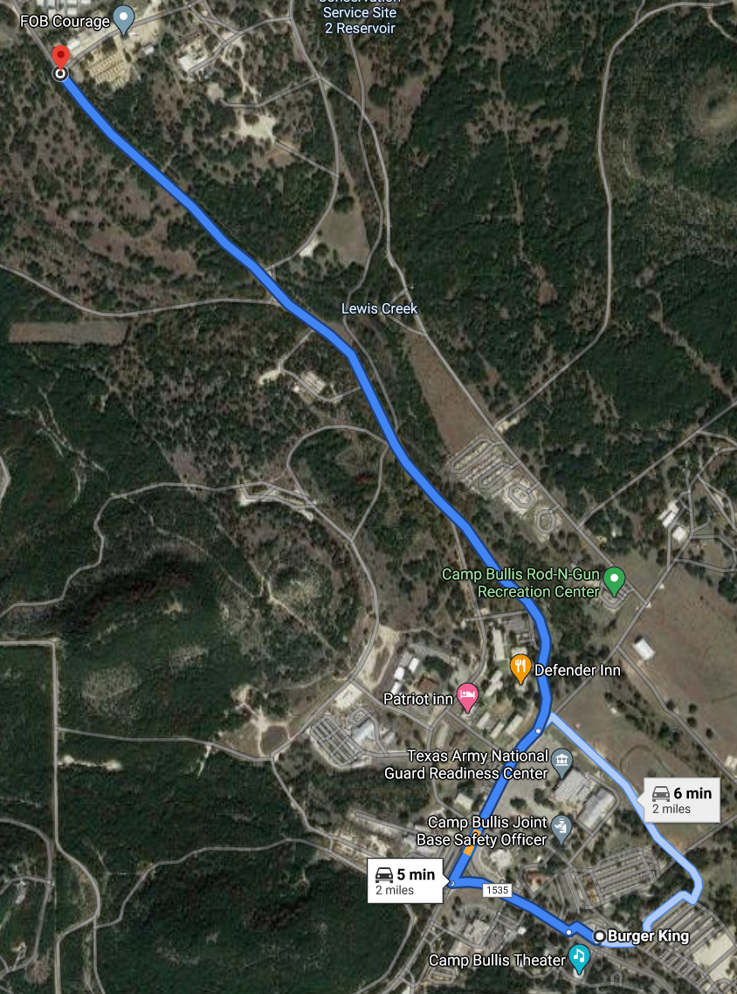
Where: Camp Bullis; FOB Courage/SMTS
When: 0945 – 1400
UOD: OCP or roughs that you don’t mind getting dirty. No “athleisure” outfits please.
Bring eye pro, gloves, head lamp, rain jacket as desired, water, food, caffeine, and any other sustainment items you desire, minus CL6.

Slide 4
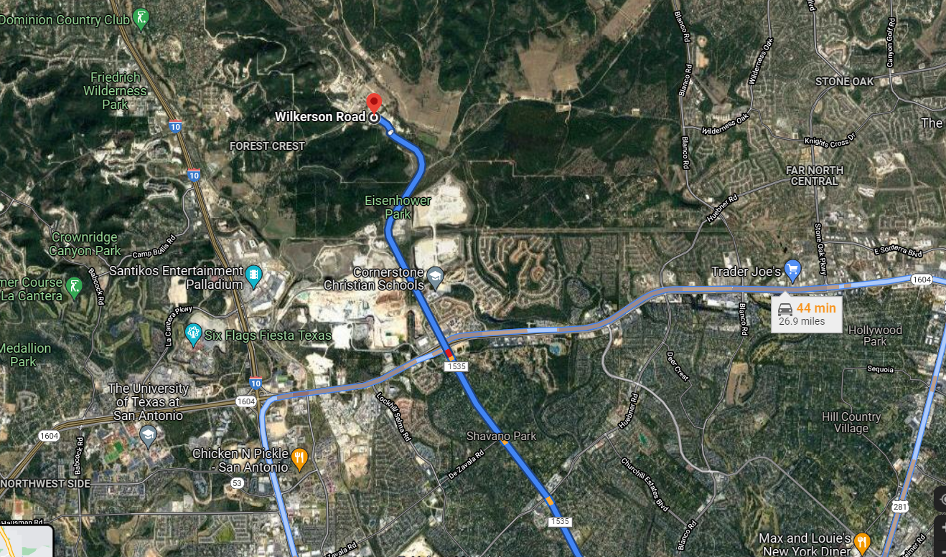
FINDING YOUR WAY THERE
- Camp Bullis is located on the NW side of San Antonio. Outside of loop 1604, just east of I-10.
- The pin dropped (red pin) is right next to the Burger King. This is a good reference point. You will pass the Burger King on the drive towards the SMTS/FOB Courage..

Slide 5
After you enter Camp Bullis, keep driving down the main road until you see the Burger King.
2) Pass Burger King and keep driving until you are forced to go right or left. Veer right at the “y”.
3) Go through a couple stop signs, then veer to the left
Note Burger King that was marked on previous slide

Slide 6
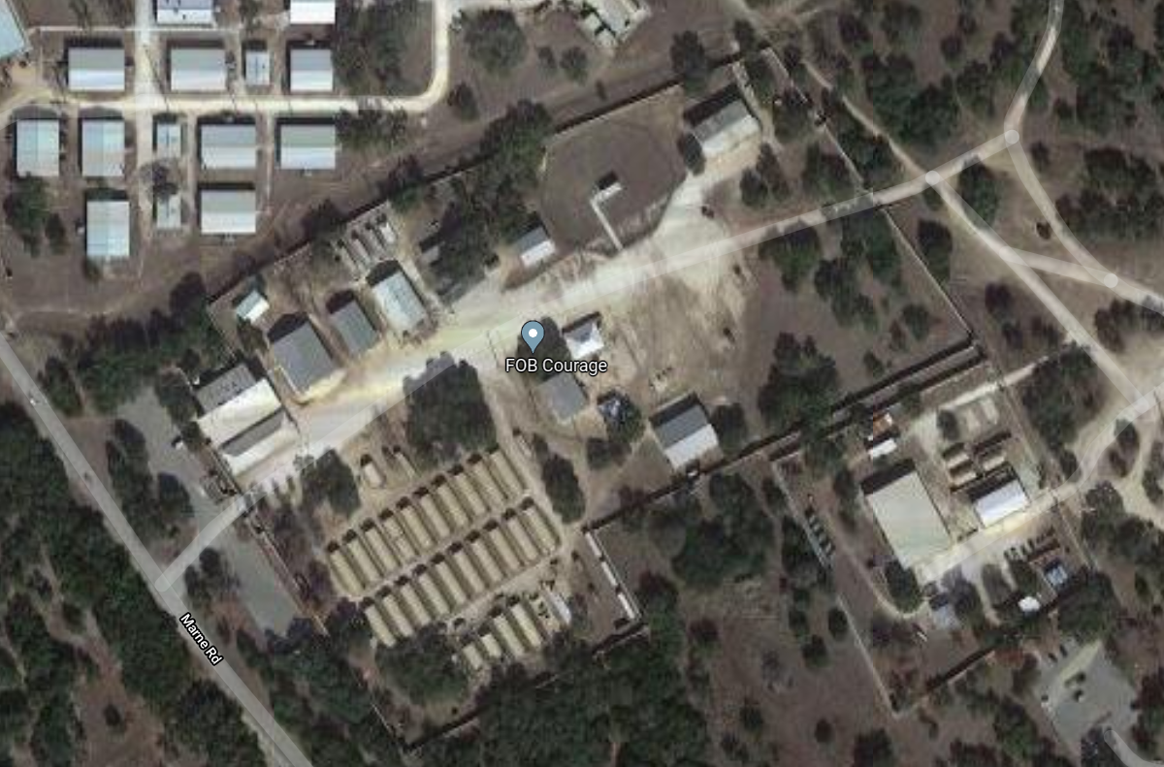
- Meet at the blue star NLT 0945.
Parking

